Slide 1
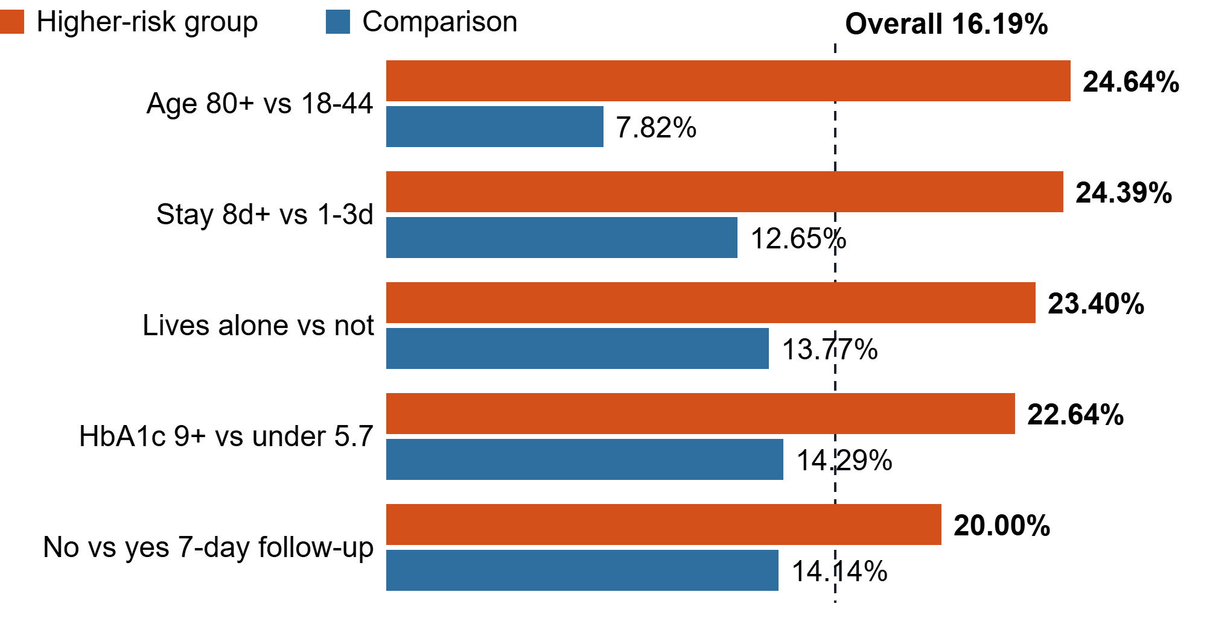
Readmission risk drivers
16.19%
13,072
2,116
overall 30-day readmission rate
admissions in reporting window
readmitted within 30 days
30-day readmission rate by patient group (%)
Top diagnoses by readmission rate
Diagnosis | n | Rate | Share
Heart failure | 1,944 | 22.74% | 20.9%
COPD | 1,369 | 19.65% | 12.7%
Kidney disease | 1,059 | 17.47% | 8.7%
Sepsis | 1,031 | 17.36% | 8.5%
Stroke | 879 | 16.72% | 6.9%
Diabetes compl. | 1,849 | 16.22% | 14.2%
Share = % of all 2,116 readmissions
Source: vw_admission_master, Jan 2024–May 2026 (n = 13,072)

Slide 2
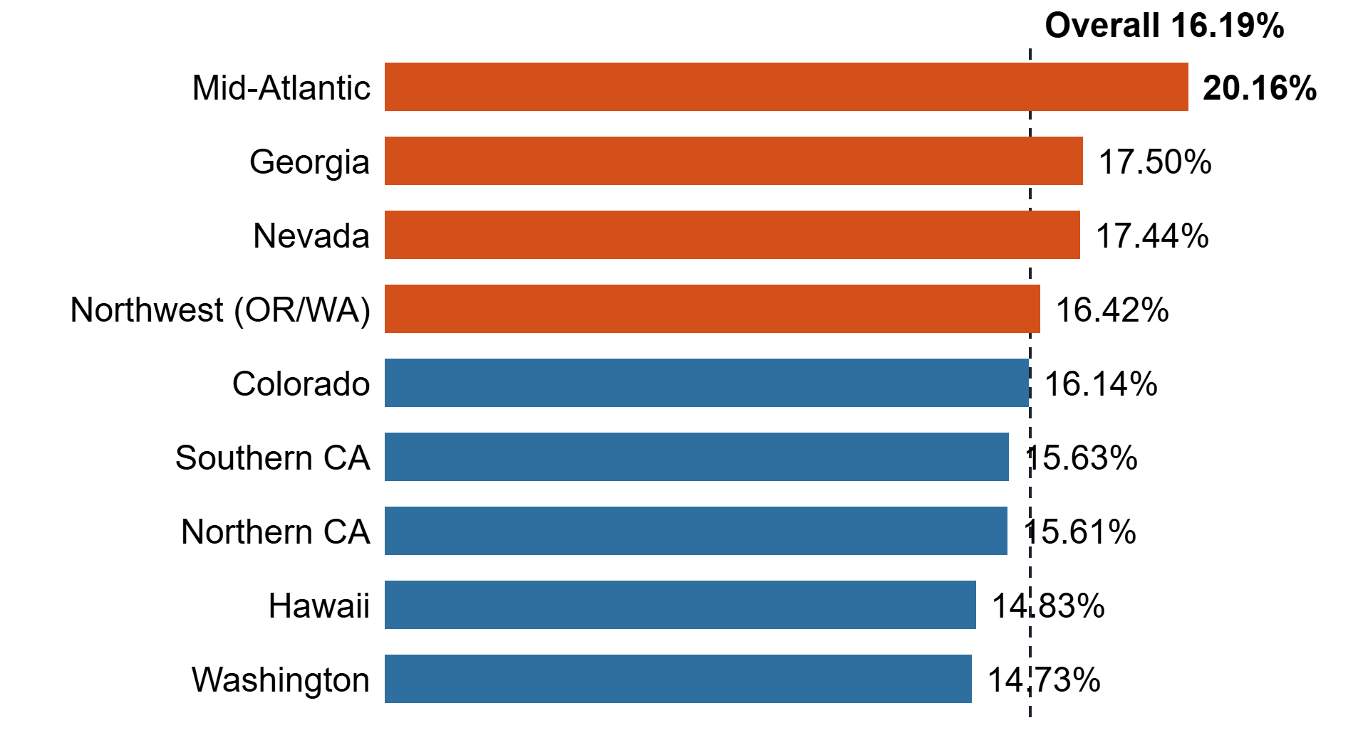
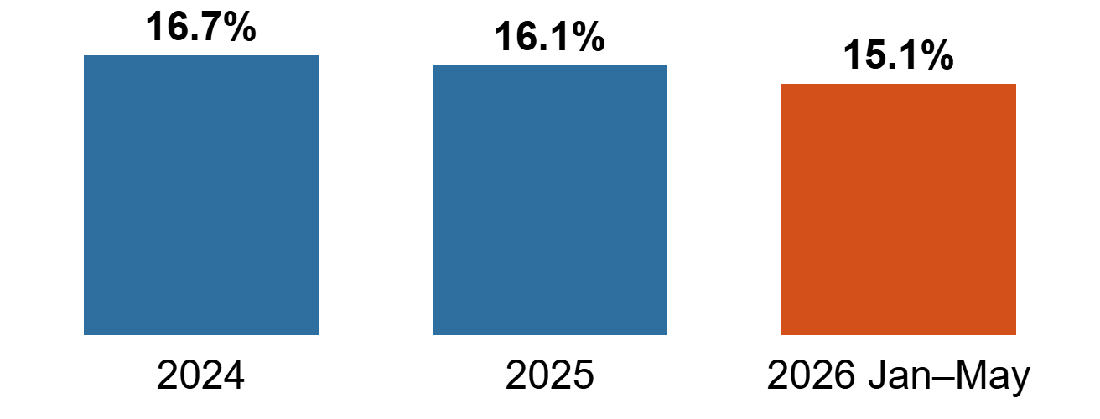
Regions, trend and cost
30-day readmission rate by region (%)
Cost of readmissions
Outcome | n | Avg cost | Total
Not readmitted | 10,956 | $15,900 | $174.2M
Readmitted | 2,116 | $18,451 | $39.0M
+$2,551 per readmitted stay (+16%). Readmissions are 16.2% of admissions but 18.3% of total cost.
Readmission rate by year (%)
Source: vw_admission_master, Jan 2024–May 2026 (n = 13,072). Open item: view holds 13,122 of 15,000 admissions.

